Slide 1

Linux 32-bit STACK Buffer Overflow

Slide 2
Agenda:
Introduction
How normal code get executed
Environment
How vulnerability occur
How to exploit ?
Demo …

Slide 3
INTRODUCTION:
This vulnerability allows an attacker to run arbitrary instructions on the victim machine
This vulnerability has many names “Memory corruption, Buffer overflow, Stack-Based overflow”.
The first known exploitation was in 1988 as part of Morris worm
The first publication was titled "Smashing the Stack for Fun and Profit“ in 1996 by Phrack.

Slide 4
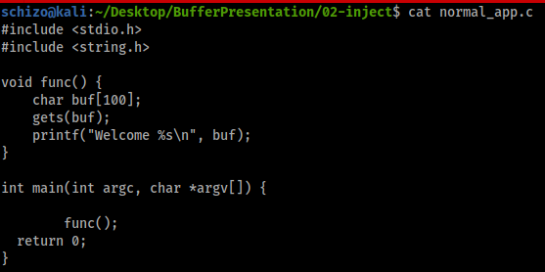

Normal Code

Slide 5

How Does it work ?
Operating System provide the program many Things to run it
We are interested in two things:
1- Stack
2- Registers

Slide 6
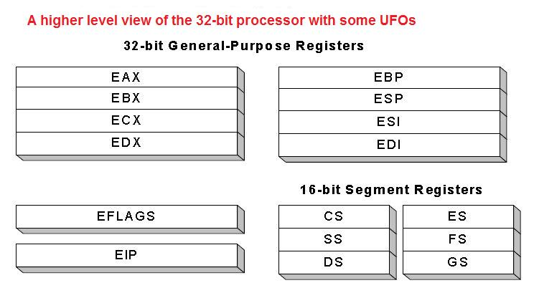
Pre-Request: Registers
We Are interested in two registers:
ESP: Stack Pointer
EIP: Instruction Pointer

Slide 7
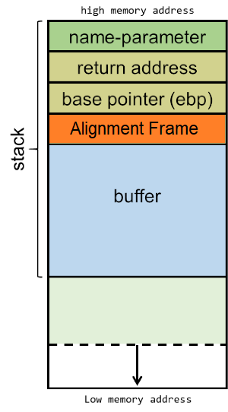
Pre-requests: stack
Return Address: Where the OS go if it finished the executing a function
Buffer: Where function’s data resides

Slide 8
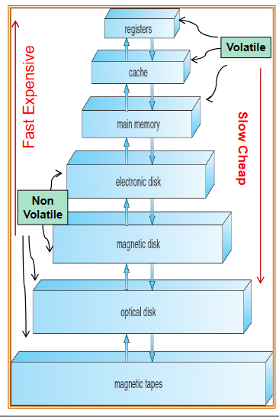
FYI: What is the Difference ?
Registers:
Located in the CPU
Much faster
Very expensive
Small size
Stack:
Located in the RAM
Slower comparing to Registers
Little bit cheap
Bigger size
Registers is a memory pieces located in the CPU.
Stack is a data structure located in the RAM.

Slide 9
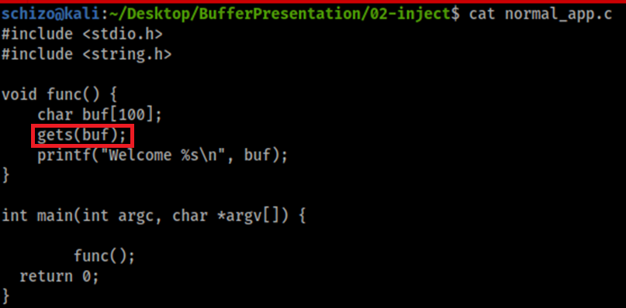
Spot the Vulnerability !
strcpy(char* destination, const char* source);
strcpy function supposes developer will make sure to have enough buffer space to copy string from source to destination.
strcpy has no limit to copy so it is vulnerable by Bufferoverflow.

Slide 10
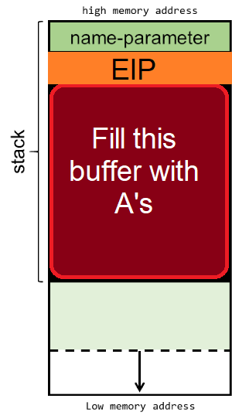
exploiting Buffer overflow
Our plan is:
Fill the buffer with junk chars like A’s
Take control of EIP register
If we success to take control of EIP we have two method to gain RCE:
Reuse the code (demo 1)
Inject shellcode (demo 2)

Slide 11
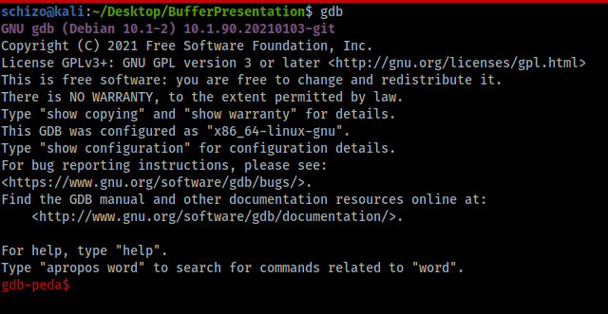

Tools needed:
gdb (The GNU Project Debugger):
peda extension
https://github.com/longld/peda

Slide 12

Step1: crash the Program
The signal that indicates existence of buffer overflow vulnerability is crashing program and through “segment fault error”.
segment fault error means that EIP register hold an address that doesn’t exist. (( بالعربي ضيع البرنامج

Slide 13

Step2: Fuzzing
We need to Identify how many bytes we need to override the EIP register.
Blindly Fuzzing
RE (Pro Tip)

Slide 14
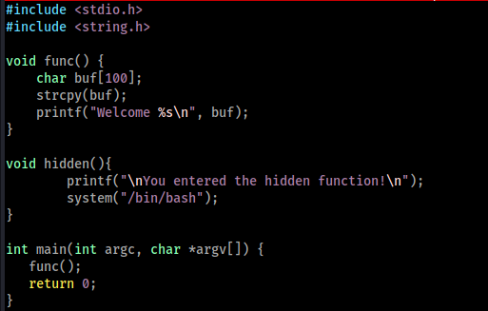
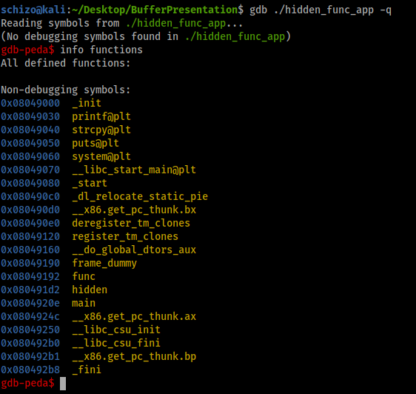
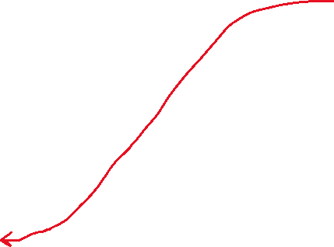
STEP3-a: code Reuse Attack

Slide 15
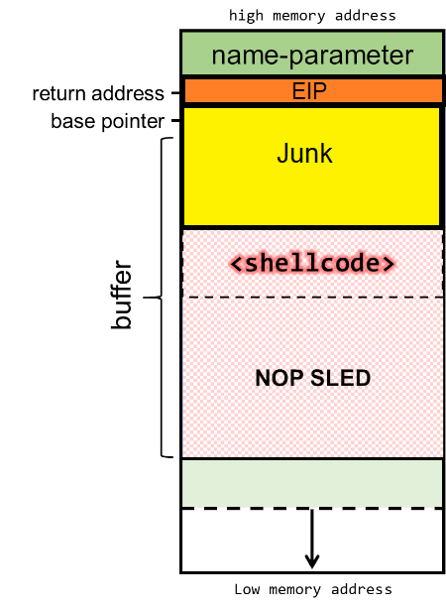

Step3-B: Code Injection

Slide 16
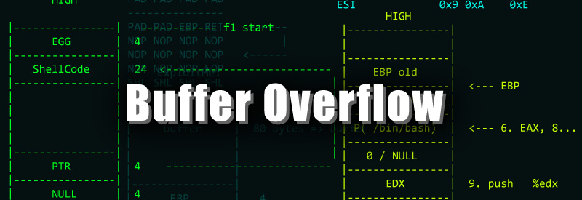
Demo …
Basic Buffer Overflow

Slide 17
CTF Time!

Slide 18
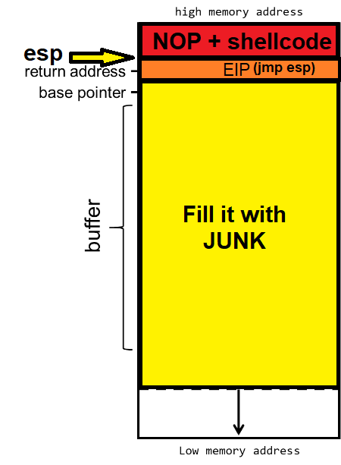
FOR Remote exploitation
ESP register always point to the top of the stack

Slide 19

Resources to go deep:
XDS elearnsecurity
https://exploit.education/phoenix/
https://www.coengoedegebure.com/buffer-overflow-attacks-explained/
https://guyinatuxedo.github.io/

Slide 20

THANK YOU
Twitter: @5ch1zo
https://ischizo.com

